Slide 1
Marching to Waziristan
And Some Very Interesting Conversations
Along the Way

Slide 2
Pakistan on the Map

Slide 3
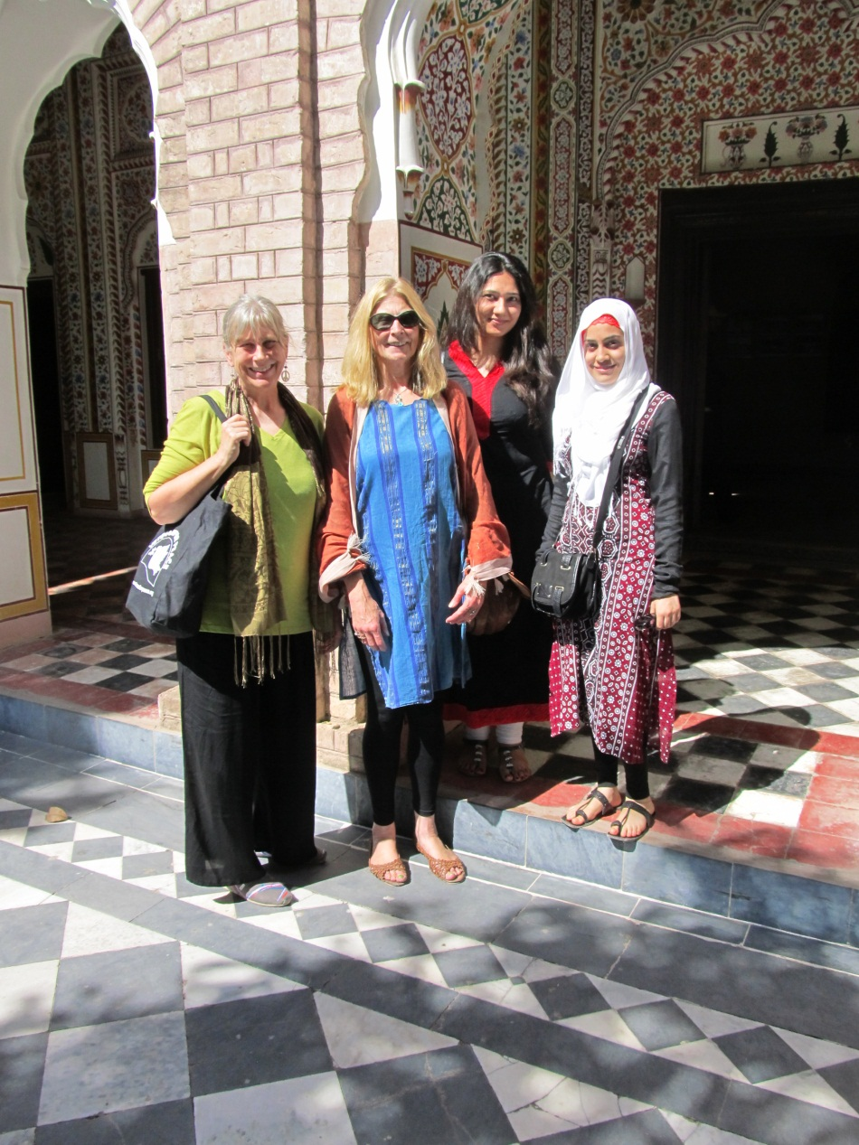
Shahzad Akbar
Of The Foundation
For Fundamental Rights
Shahzad’s Assistants, Marya and Maryam
With Leah Bolger and Me at Said Pur Village

Slide 4
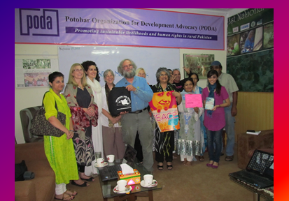
Sameena Nazir PODA/WILPF

Slide 5
WILPF and Us

Slide 6
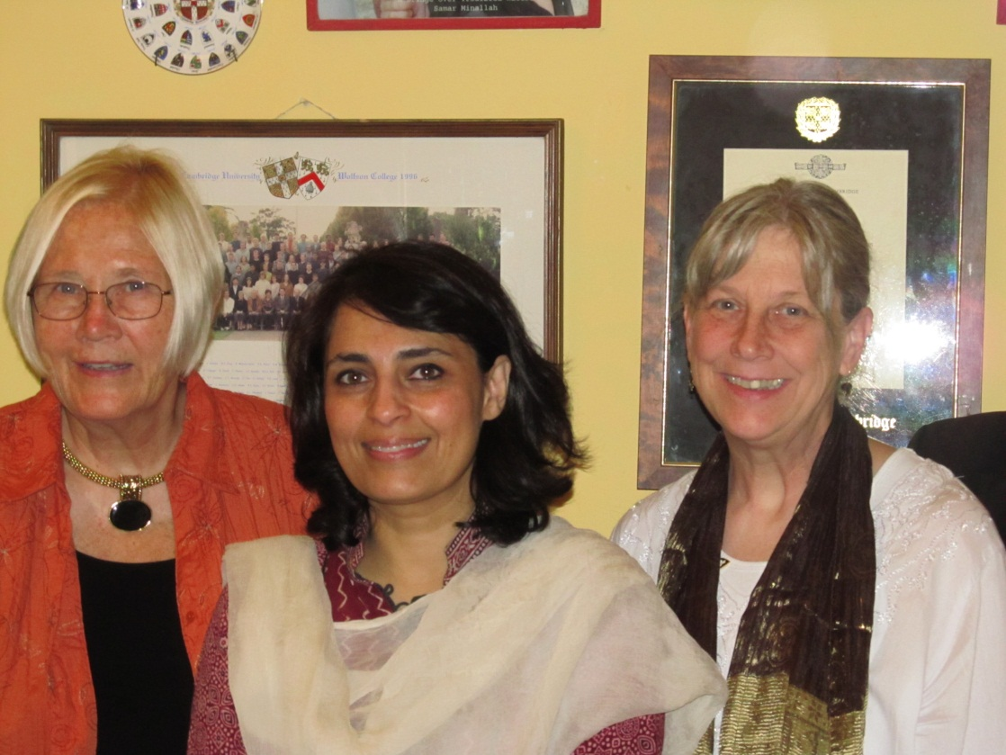
Tariq Azim Information Minister MLN
Samar Minallah
Anthropologist
Film Maker
Advocate For Tribal Women

Slide 7
Institute of Strategic Studies DRONES AS A . . .

Slide 8
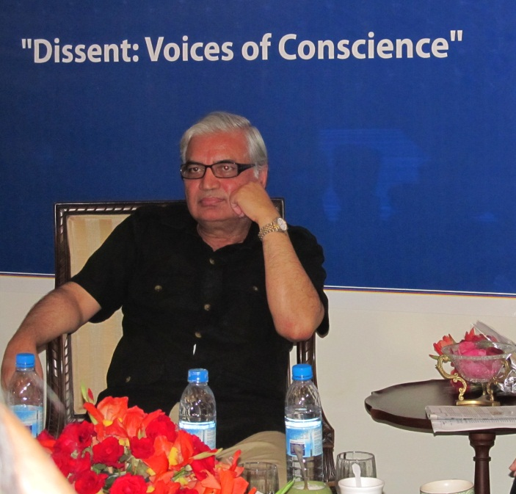
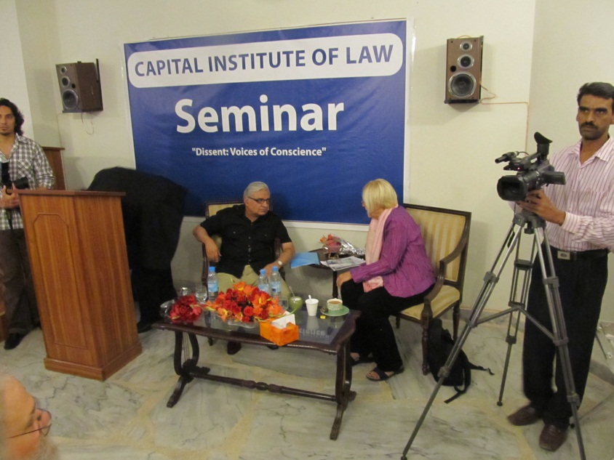
Capital Law School

Slide 9
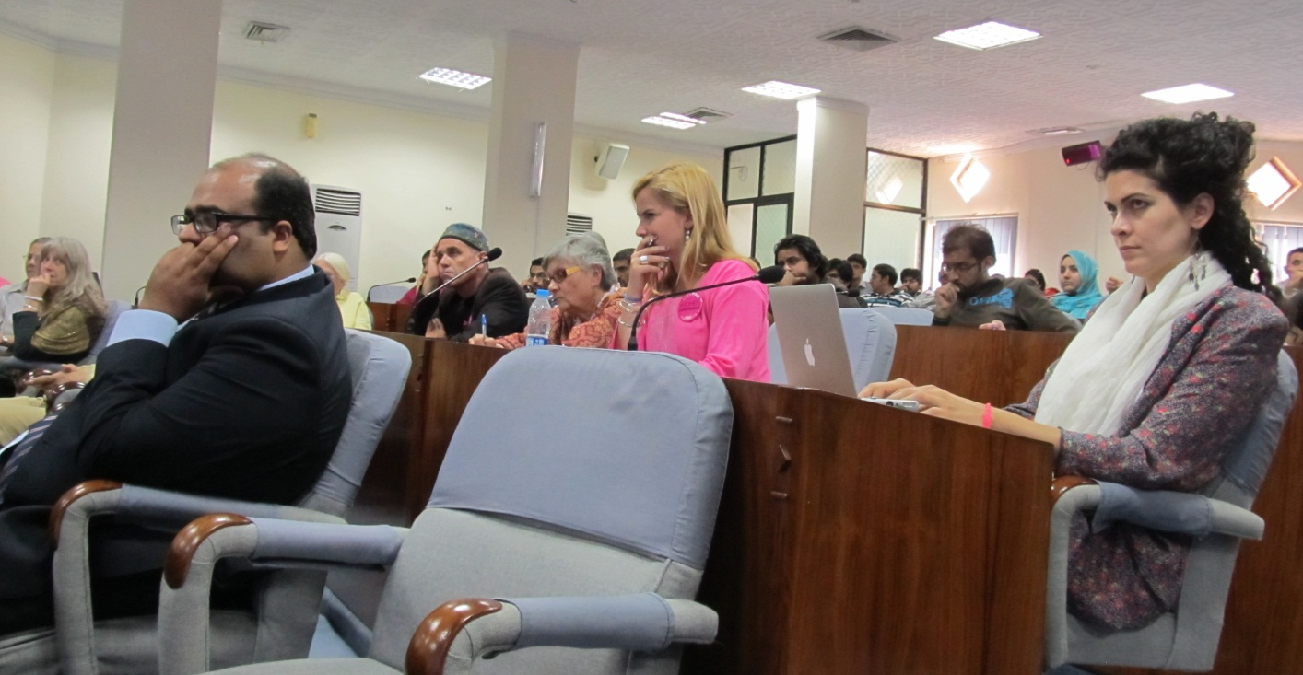
At the Military College

Slide 10
Shmoozing at the Military College

Slide 11
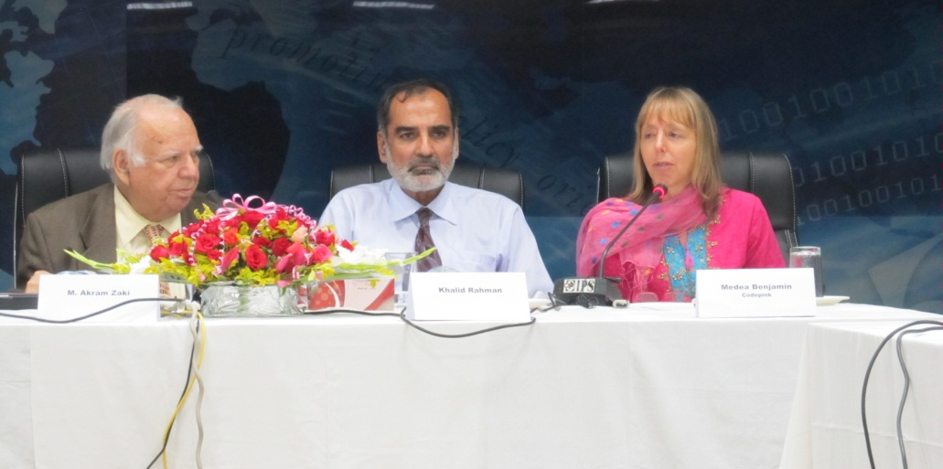
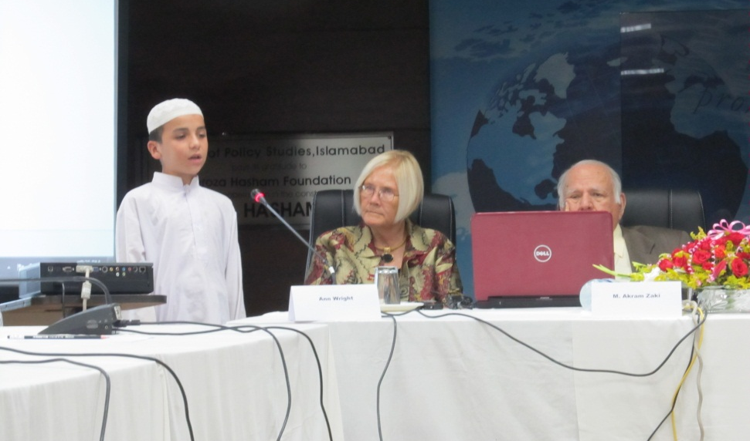
Institute for Policy Studies

Slide 12
Samar Minallah

Slide 13
In One Afternoon
Dr Fowzia Siddiqui & Altaf Shakoor
Ambassador
Hoagland

Slide 14
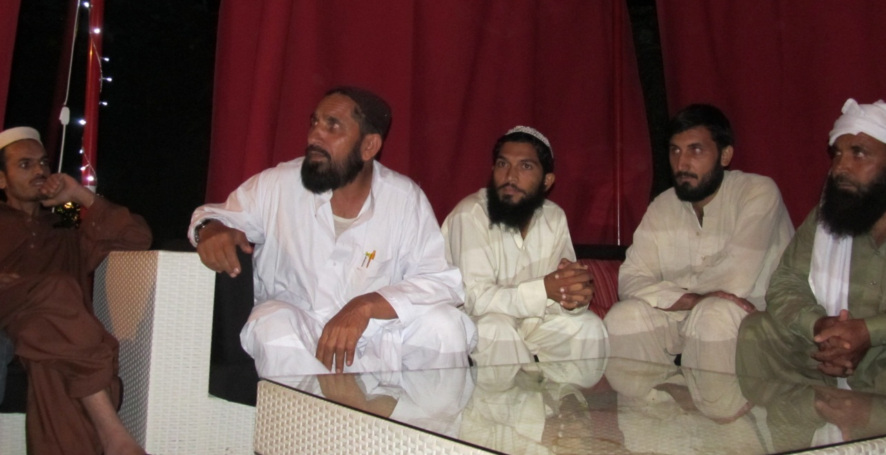
Victims of the US War on Terror

Slide 15
Drone Attacks in Waziristan

Slide 16
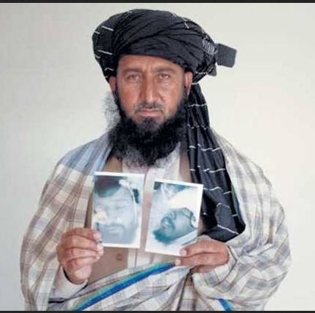
Meeting the Drone Victims

Slide 17
Child Victims of Drone Attacks

Slide 18
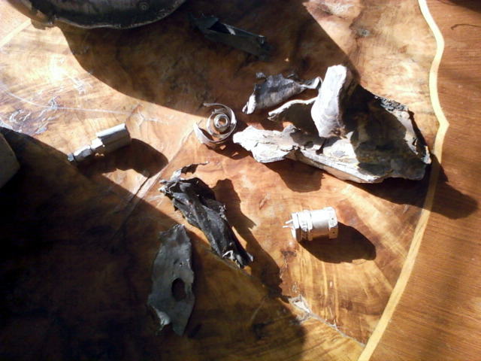
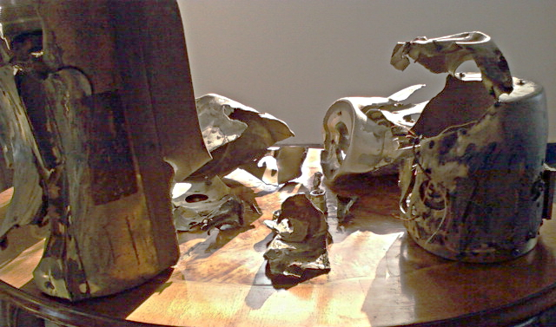
Hellfire Missiles

Slide 19
FATA: Federally Administered Tribal Area

Slide 20
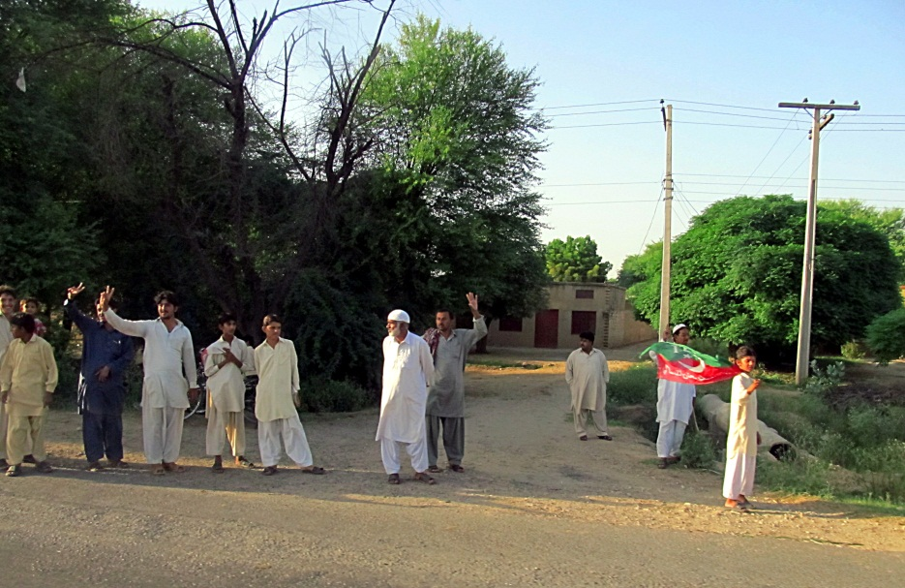
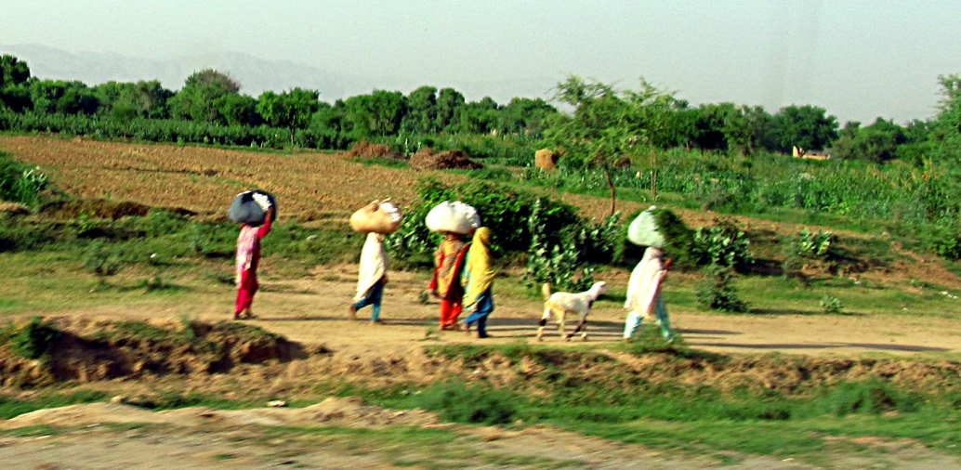
The Road to Waziristan

Slide 21
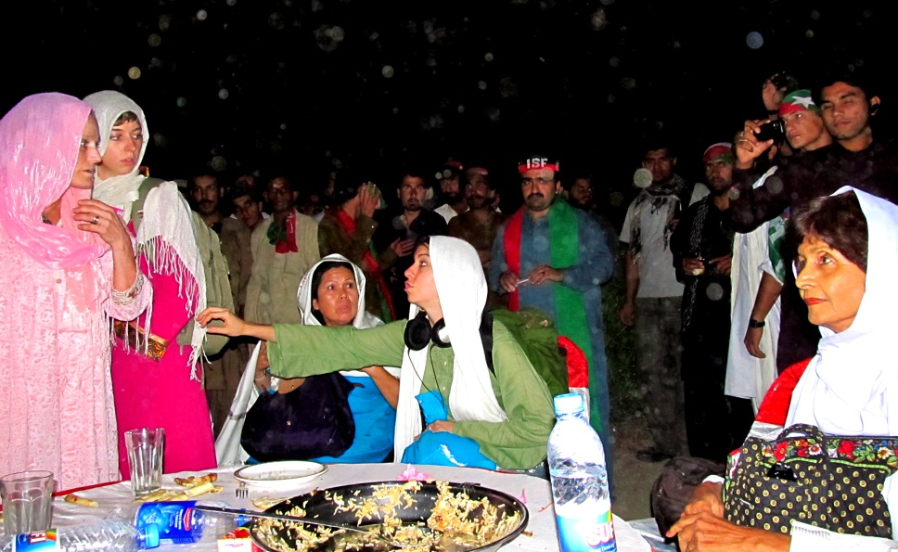
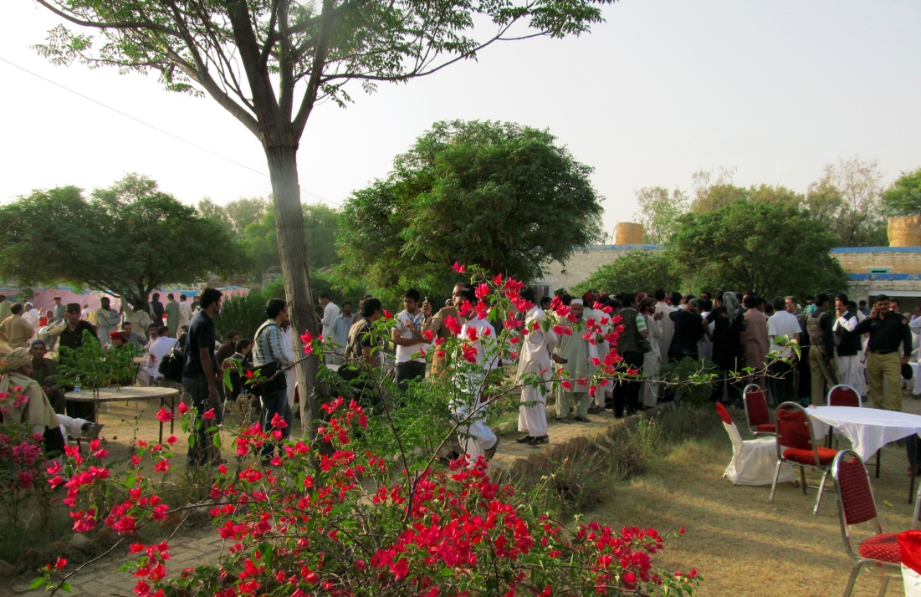
Compound in Tank

Slide 22
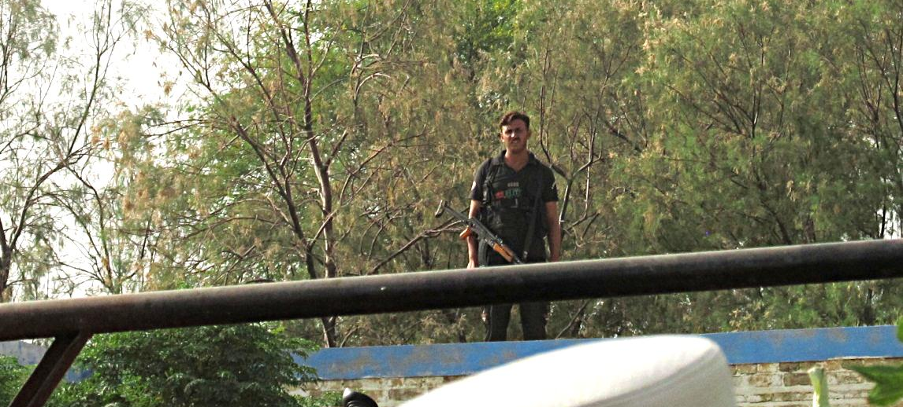
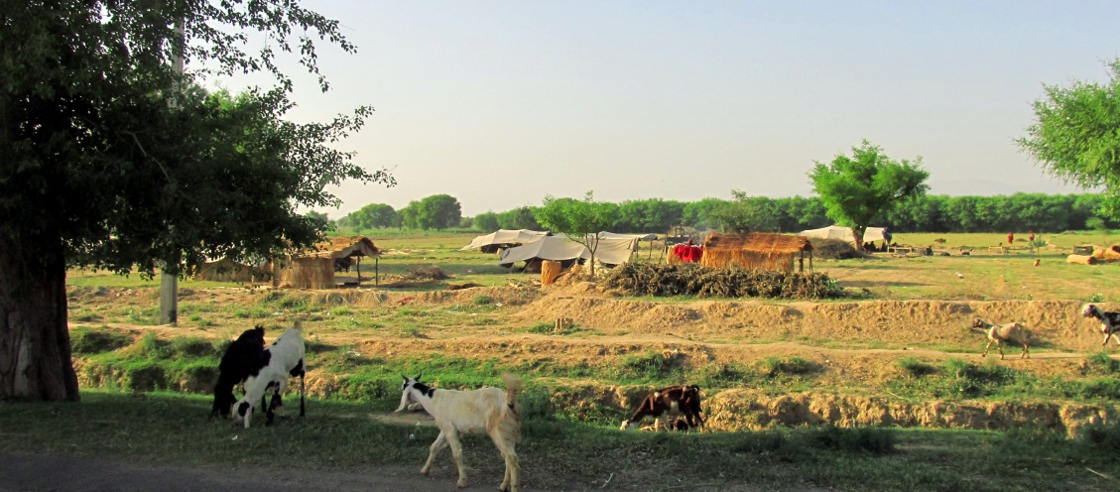
Goodbye FATA

Slide 23
Bloody Shrouds Drone Action

Slide 24
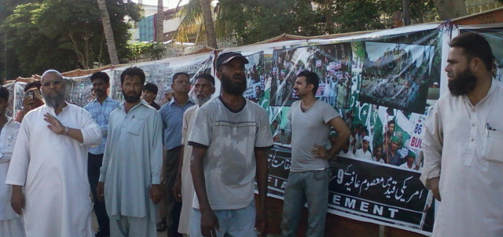
People for Aafia

Slide 25
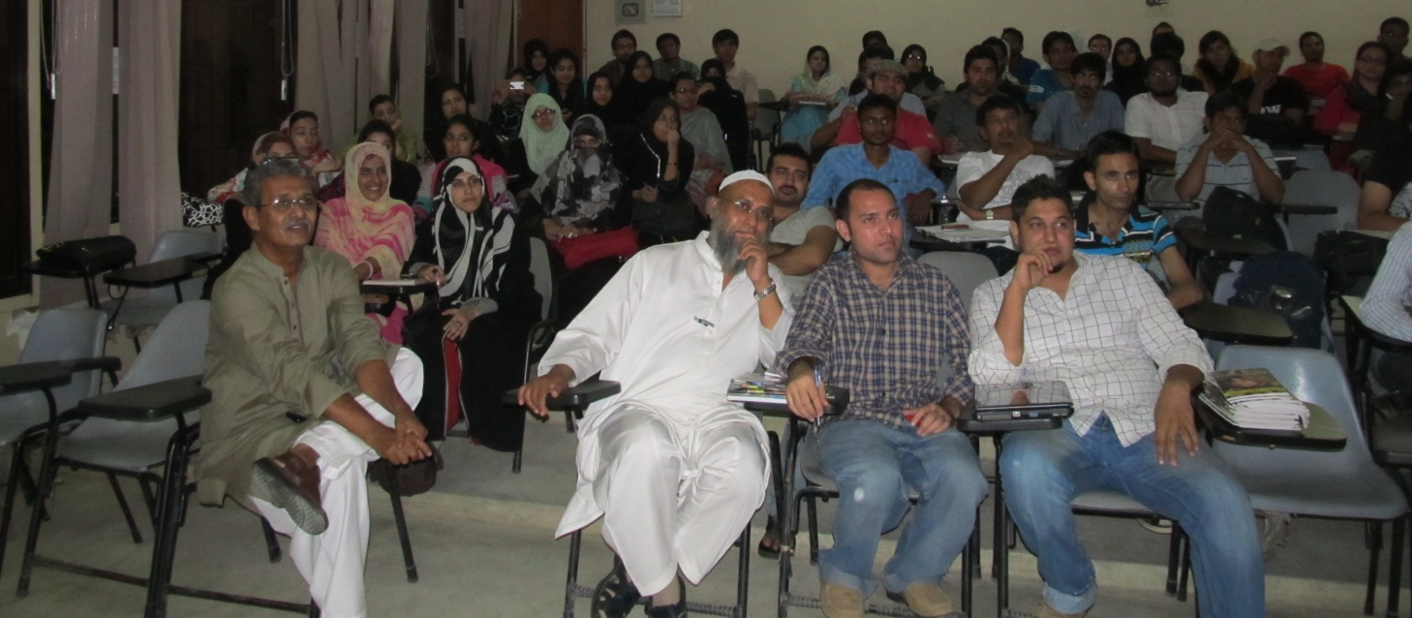
Lecture at Karachi University

Slide 26
judith@papillonweb.net
http://blog.papillonweb.net
http://blog.upstatedroneaction.org

